Slide 1


Model Build 5
GNG algorithms
Presenters: Yemi Odeyemi & Shay Kazemlou
2020 December 14

Slide 2
AGENDA
TRR: GNG algorithms with acceptable performance and ID independence
Comparative Analysis of EA results of Cephalosporins
EA Assessment for ID- Independent Models
General and Breakout time (Fast, Medium and Slow Growth) models
Model Noise Detection : Principal Component Analysis
Summary
MB6

Slide 3
TRR D1 and D2: GNG algorithms with acceptable performance and ID independence
TRR Item # | Description | Model Build Intent | Risk Burn Down Current RPN Planned RPN |  | Approvers
D1 | EA is not met because we don't have the required/relevant information for the algorithm to be able to predict growth/no growth | Build Algorithm with acceptable performance (10/1 Aim to build algorithm with two drugs) | 9 | 9 | Gina Ewald
D2 | Multiple algorithms are needed based on different species | Demonstrate ID independence | 9 | 9 | Gina Ewald
Yet to achieve acceptable EA in 4 hours ID dependent approach for all drugs and orgs (attained acceptable EA in ~60 % of our model)
We cannot retain ID independence and may require separate models for drugs, organism or both
Notes:
We are yet to burn down the risk because it looks increasingly likely that we cannot retain ID independence with one model and thus may require separate models for drugs, orgs or both.
On that note, we have collected more data since our last model build (MB4) , and explored other features

Slide 4
EA : Comparing EA Results from MB4 with MB5 (General, Fast & Medium, Slow Growth)
Drug | Random Forest Model | E. coli | K. pneumo | P. mirab | E. cloacae
CAZ | MB4 | 80.0 | 58.3 | 73.3 | 84.2
 | MB5 (General) | 87.2 | 70.0 | 59.3 | 50.0
 | MB5 Fast & Medium Growth | 93.8 | 76.5 | 63.6 | 52.4
 | MB5 Slow Growth | 71.4 | - | 80.0 | 63.6
CFPM | MB4 | 82.4 | 70.0 | 44.4 | 45.5
 | MB5 (General) | 87.5 | 69.5 | 65.4 | 57.6
 | MB5 Fast & Medium Growth | 90.9 | 71.4 | 73.1 | 77.3
 | MB5 Slow Growth | 62.5 | 100.0 | - | 25.0
Note: General acceptable EA score is ‘> 90’. Colors used in this slide for MB4-MB5 EA comparison only.
Comparing EA results from MB4 with MB5, significant improvement was observed in CFPM, not so much in CAZ.
CAZ and CFPM had undeterminable MIC for K. pneumoniae and P. mirabilis respectively.
Notes:
We wanted to investigate if the performance will improve if we split into these three groups
Early indications that EA can be improved if the rate of growth in the growth well is used as a feature in the AI algorithm to split rapid growers (e.g. E. coli), moderate growers (e.g. E. cloacae) and slow growers (e.g. P. aeruginosa).
Moderate and slow growers may need additional time to make an accurate prediction.
On this note, we will be presenting EA results for three models namely: General, Fast & Medium and Slow Growth

Slide 5
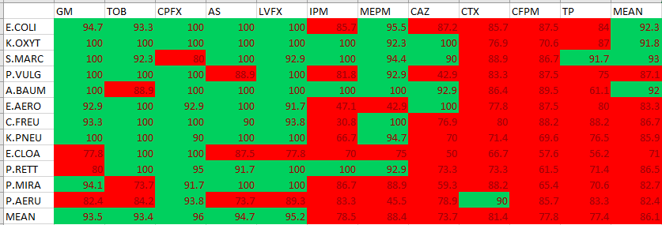
Random forest- General model all data points: 73,342 (train and test sets) Cycles: 9 = 4 hours
EA results on the test set (18,163 data points)
The G/I prediction for some drugs (e.g., CAZ, CTX, CFPM, TP) is more challenging than some other drugs (e.g. LVFX and CPFX )

Slide 6
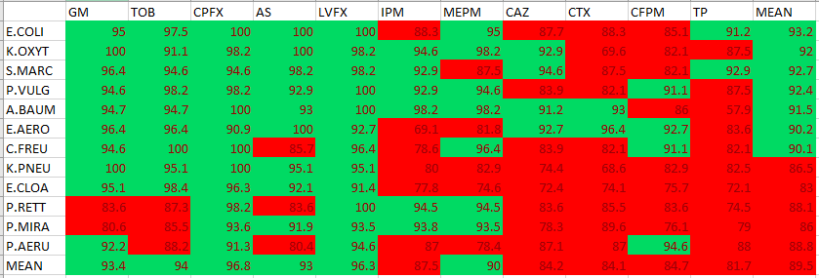
Random forest- General model all data points: 73,342 (train and test sets) Cycles: 9 = 4 hours
EA results on all data (train and test sets: 73,342 data points)
The results on the full data (train +test) has slightly higher accuracy comparing to the test set, however it is not significantly different. Again the drugs on the left side of the table have higher accuracy.

Slide 7
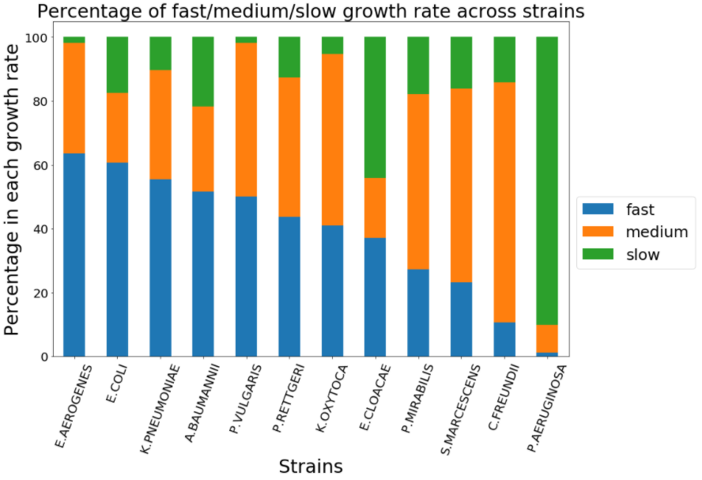
Splitting data based on rate of growth well per isolate
Fast=growth well is clearly mid log by 3 hours.
Medium = approaching mid log by 3 to 3.5 hours.
Slow = approaching mid log by 4 hours. Use more time to make MIC determination
Splitting the data based on the growth rate does not cluster by species…
Except for P. Aeruginosa for which 90% of the organisms have slow growth rate

Slide 8
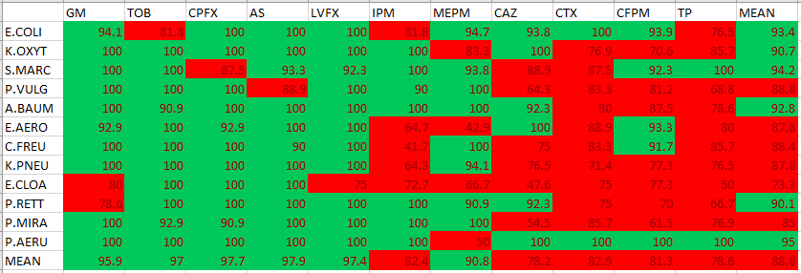
Random forest- Fast and medium growth rate all data points: 56,294 (train and test sets) Cycles: 9 = 4 hours
EA results on the test set (13,868 data points)
The model built for organisms with fast and medium growth rate performs better than the general model.
Significant improvement is observed for E. Coli and CFPM.

Slide 9
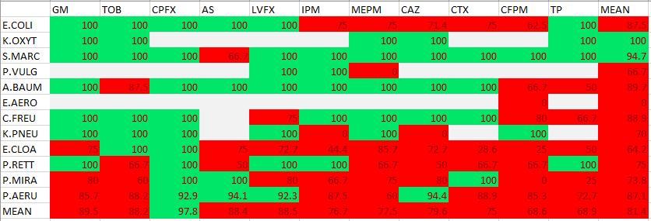
Random forest- General model – Slow growth all data points: 16,829 (train and test sets) Cycles: 11= 5 hours
EA results on the test set (4,260 data points)
Note: The EA results in this table are not reliable for some of the strain-drug combinations due to the low number of tests
Separating the slow growth organisms improved the prediction for P. Aeruginosa which has slow growth rate

Slide 10
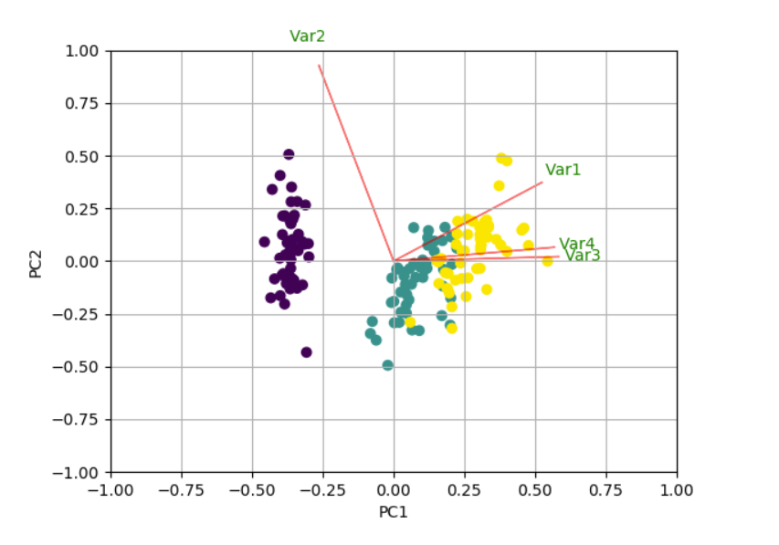
EA Performance Assessment: Principal Component Analysis (PCA)
PCA is dimension reduction technique which takes set of possibly correlated variables and transforms into linearly uncorrelated principal components.
It is used for :
exploratory data analysis and predictive modeling
to emphasize variations and bring out strong patterns in a dataset.
To assess the impact of feature variance in predictive models
Importance of PCA: shows clusters of samples based on their similarity; identify key contributing features and assess pairwise correlation among the features
Notes:
Due to the low EA scores in the cephalosporins, we decided to employ PCA to assess for the degree of randomness (that is noise) in the cephalosporin models
PCA is a mathematical algorithm that reduces the dimensionality of the data while retaining most of the variation in the data set. It is important to note that PCA does not discard any samples or features
It is used to emphasize variations and bring out strong patterns in a dataset.
In our case, we used PCA to
(1) assessed the impact of feature variance in the GI model- what class (G or I) has more spread and variance
(2) identify statistically significant contributors to the Principal Components
(3) Assess pairwise correlation among the features
******* explain the figure- orthogonality / positive and negative pairwise relations between features

Slide 11
PCA: Methods
PCA for Cephalosporins- CAZ and CFPM
Comparative analysis: Select based on EA for CAZ and CFPM (worst) with drugs with the best result (LVFX and CPFX).
Baseline Features: Area Sum and BacCount, PerimMean, Rate
Specific model: Random Forest at 4hrs
Features | Definition/key
Area Sum | total number of pixels that are not background, includes bacteria and also dust or other artifacts
BacCount | Number of objects ranging in size from 0.5 to 2 microns in size
PerimMean | length of the outside boundary of an “object” as determine by the HHT imaging program.
Rate | ((Count at cycle x+1)-(Count at cycle x)/(count at cycle x)),
Basis for Variance Comparison: Some drugs had acceptable EA across board (Ex. CPFX) while the Cephalosporin recorded low EA scores
Notes:
Comparison of extreme drug EA performance
In order to determine the most prominent features in our models, we used Area Sum and BacCount as baseline along with the perimeter mean and Rate features for the PCA

Slide 12
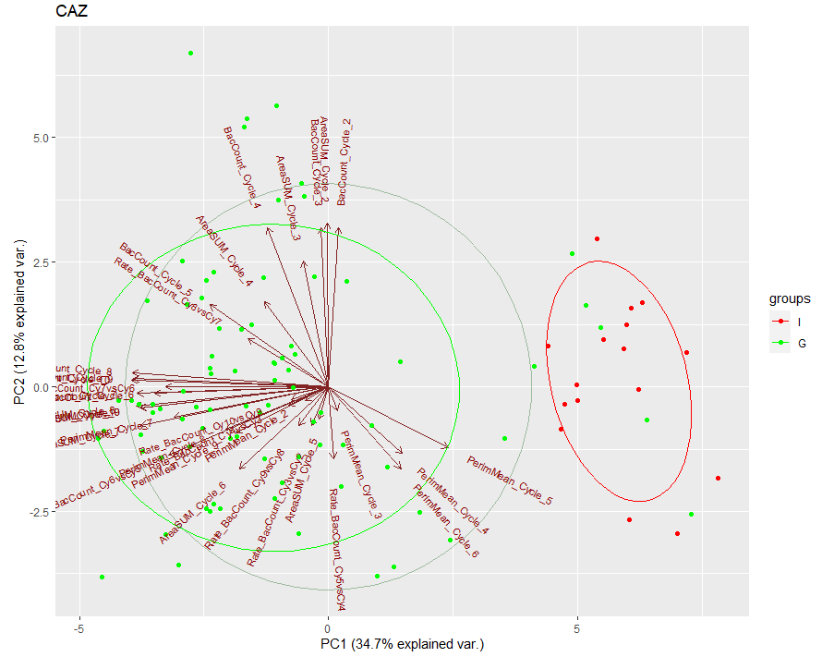
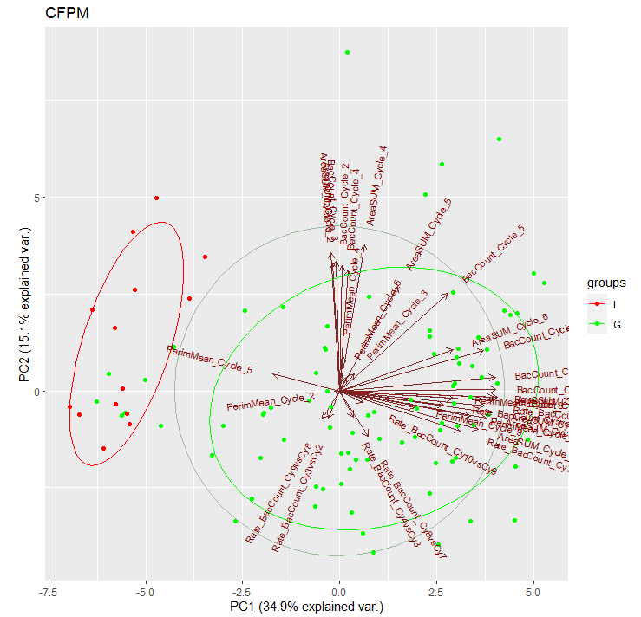
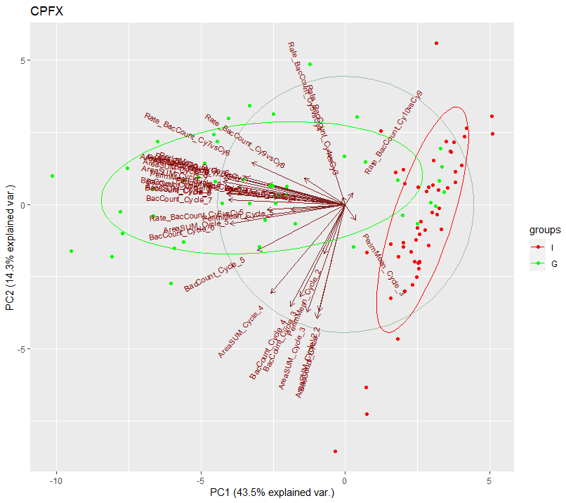
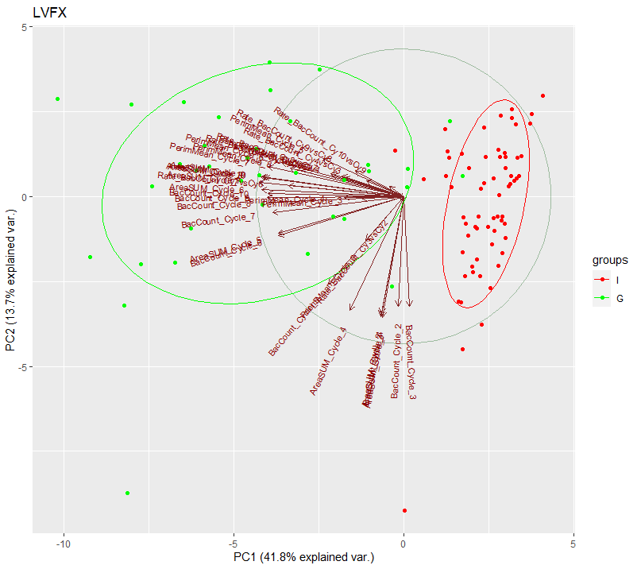
PCA: Fast/Medium Growth
Sparsity in the scatterplots: Significant noise detected in the cephalosporins when compared with LVFX and CPFX
Notes:
Larger variance observed in the cephalosporins
PCA Contribution - Area_sum and bac_count are the most dominant features in the principal components

Slide 13
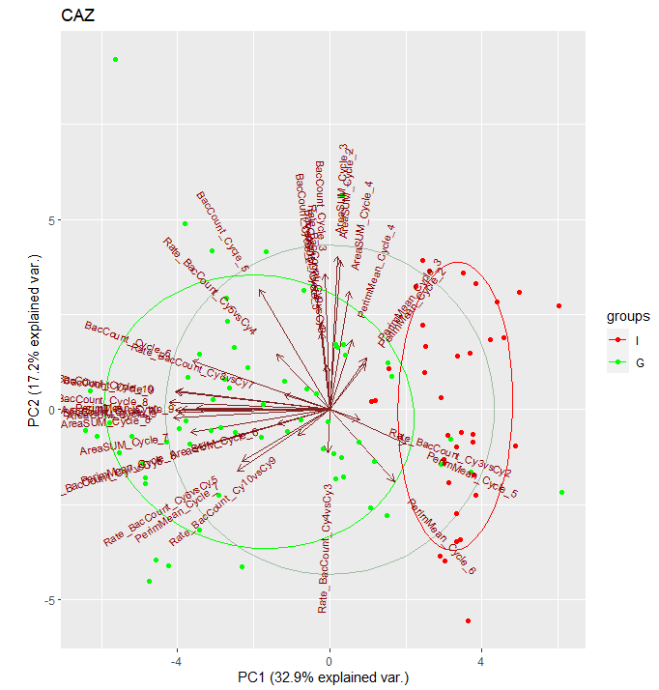
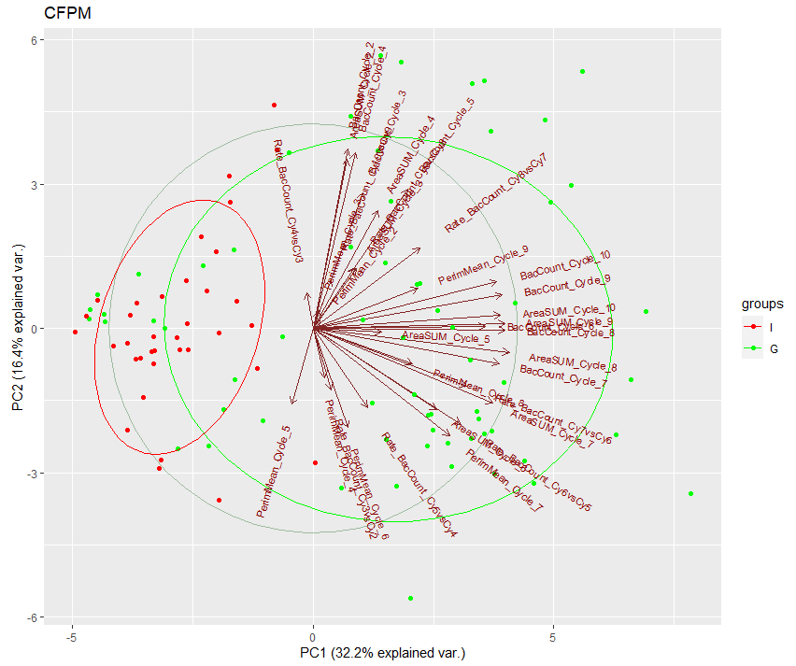
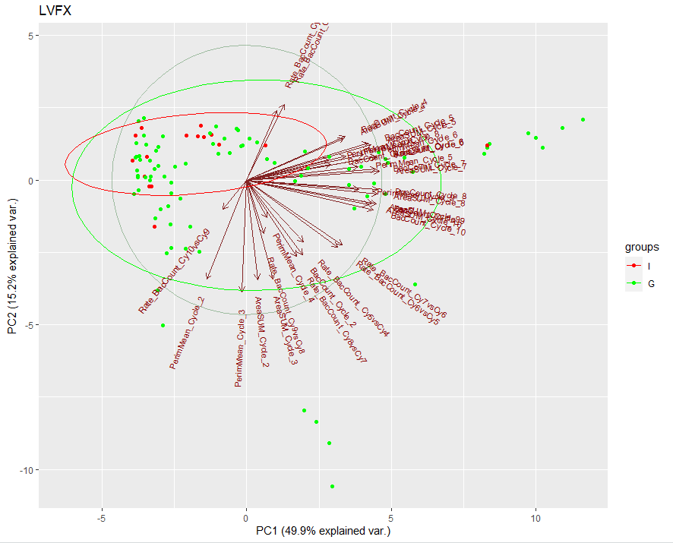
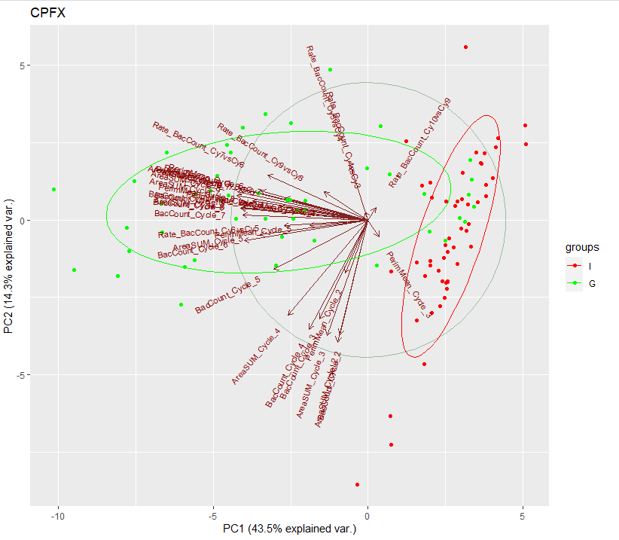
PCA: Slow Growth
Sparsity in the scatterplots: Significant noise detected in the cephalosporins when compared to LVFX and CPFX similar to the ones seen in Fast/medium Growth group
Notes:
******Just in case
***********************If somebody asks why, I think this data shows that wells that appear to be inhibited wells eventually grow out. Therefore we may need another parameter or feature to differentiate************************************************.

Slide 14
Summary
Improvements were observed in EA scores of both General and Fast/Medium breakout time models
Breakout time models assist in identification of bacteria strain(s) that require more time to call MIC
Large variance (spread) was observed in the CAZ and CFPM when compared with LVFX ,CPFX (our two most successful drugs)
From our observation, Area_sum and bac count remain the most dominant features in the PCA, both sets of features introduce a significant degree of randomness in both cephalosporin models, thus, we will have to look into other features for a better EA results, including:
ID dependent models
Other NEI features for cephalosporins to better separate elongation from escaping bacteria.
Better use of the information of surrounding drug type and drug dilution.
Model based on MIC, not separate Growth and Inhibition calls for wells independently.
Notes:
Strikingly, we observed that Area sum and bac count remains the most dominant features in the PCA, this indicates that the aforementioned features are noisy in the cephalosporins, thus, we will have to look into other features for a better EA results, This further bolster the idea of building ID-dependent models

Slide 15
TRR D1 and D2: GNG algorithms with acceptable performance and ID independence
TRR Item # | Description | Model Build Intent | Risk Burn Down Current RPN Planned RPN |  | Approvers
D1 | EA is not met because we don't have the required/relevant information for the algorithm to be able to predict growth/no growth | Build Algorithm with acceptable performance (10/1 Aim to build algorithm with two drugs) | 9 | 9 | Gina Ewald
D2 | Multiple algorithms are needed based on different species | Demonstrate ID independence | 9 | 9 | Gina Ewald
Next steps …..

Slide 16
MB6 plans
Focus on gram pos algorithms
Take a step back on the gram negs to consider the following:
Feature Extraction/ Engineering: Continue to identify ways to improve the EA by including computer vision derived features in our tree-based models
Feature Exploration: Look at other features such as Logarithm of growth count, SIR distance, Weights on drug dilutions, Addition of image-based features such as
From all our analyses, we will be looking at ID- dependent models for optimal results
We will continue to assess and evaluate breakout time-based models ( incorporation of fast /slow growth signal in the model)
There are separate presentations to discuss:
Deep Learning vs Machine learning (within the next few weeks).
CSS performance (part of software model builds).
Notes:
Other features may be looked at for specific drugs.
For beta-lactams: Proportion of elongated cells vs normal cells, and the rate of change in the proportion.
Different model structures by drug—Neural Network for beta-lactam drugs, vs tree-based classifier(s) for other drugs.

Slide 17

THANK YOU

Slide 18
Hierarchy of Model structures
One Model, Drug and species independent
preference
Model for each drug, species independent
One Model, uses species info as a feature
Model for each drug, species info as a feature
Mosaic of models- drug and genus/family dependent.
Individual Models for each drug and species

Slide 19
Random forest- General model all data points: 73,342 (train and test sets) Cycles: 9
 | GM | TOB | CPFX | AS | LVFX | IPM | MEPM | ST | CAZ | CTX | CFPM | TP | SUM
E.COLI | 151 | 125 | 212 | 221 | 277 | 135 | 191 | 0 | 350 | 112 | 351 | 223 | 2348
K.OXYT | 103 | 80 | 95 | 77 | 103 | 86 | 102 | 0 | 88 | 103 | 134 | 183 | 1154
S.MARC | 136 | 103 | 79 | 126 | 112 | 103 | 143 | 0 | 80 | 144 | 118 | 95 | 1239
P.VULG | 104 | 120 | 136 | 63 | 144 | 88 | 110 | 0 | 112 | 96 | 126 | 128 | 1227
A.BAUM | 128 | 183 | 120 | 105 | 207 | 160 | 149 | 0 | 112 | 174 | 182 | 163 | 1683
E.AERO | 112 | 88 | 112 | 84 | 95 | 133 | 56 | 0 | 77 | 72 | 127 | 80 | 1036
C.FREU | 120 | 135 | 112 | 70 | 126 | 104 | 162 | 0 | 104 | 160 | 134 | 136 | 1363
K.PNEU | 184 | 107 | 98 | 154 | 180 | 118 | 180 | 0 | 179 | 62 | 197 | 165 | 1624
E.CLOA | 80 | 128 | 112 | 112 | 214 | 159 | 128 | 0 | 256 | 120 | 269 | 128 | 1706
P.RETT | 120 | 136 | 160 | 83 | 104 | 112 | 111 | 0 | 120 | 120 | 104 | 56 | 1226
P.MIRA | 140 | 151 | 109 | 137 | 286 | 118 | 150 | 0 | 235 | 140 | 212 | 135 | 1813
P.AERU | 159 | 174 | 131 | 137 | 262 | 142 | 100 | 0 | 148 | 84 | 307 | 100 | 1744
SUM | 1537 | 1530 | 1476 | 1369 | 2110 | 1458 | 1582 | 0 | 1861 | 1387 | 2261 | 1592 | 18163

Slide 20
Random forest- General model – Fast and medium growth all data points: 56,294 (train and test sets) Cycles: 9
 | GM | TOB | CPFX | AS | LVFX | IPM | MEPM | ST | CAZ | CTX | CFPM | TP | SUM
E.COLI | 135 | 85 | 132 | 179 | 213 | 96 | 151 | 0 | 295 | 80 | 287 | 152 | 1805
K.OXYT | 87 | 72 | 95 | 77 | 103 | 86 | 94 | 0 | 80 | 103 | 134 | 167 | 1098
S.MARC | 120 | 95 | 63 | 105 | 104 | 95 | 127 | 0 | 72 | 128 | 102 | 79 | 1090
P.VULG | 104 | 120 | 136 | 63 | 136 | 80 | 102 | 0 | 112 | 96 | 126 | 128 | 1203
A.BAUM | 104 | 119 | 96 | 98 | 175 | 104 | 110 | 0 | 104 | 159 | 159 | 124 | 1352
E.AERO | 112 | 88 | 112 | 84 | 95 | 133 | 56 | 0 | 77 | 72 | 119 | 80 | 1028
C.FREU | 88 | 104 | 96 | 70 | 94 | 96 | 154 | 0 | 96 | 144 | 94 | 112 | 1148
K.PNEU | 177 | 100 | 79 | 147 | 172 | 110 | 164 | 0 | 155 | 62 | 189 | 165 | 1520
E.CLOA | 48 | 72 | 40 | 56 | 128 | 88 | 72 | 0 | 168 | 64 | 175 | 48 | 959
P.RETT | 112 | 112 | 128 | 69 | 96 | 104 | 87 | 0 | 104 | 96 | 80 | 48 | 1036
P.MIRA | 103 | 111 | 101 | 95 | 246 | 94 | 119 | 0 | 187 | 110 | 204 | 103 | 1473
P.AERU | 24 | 23 | 16 | 14 | 16 | 16 | 15 | 0 | 8 | 8 | 8 | 8 | 156
SUM | 1214 | 1101 | 1094 | 1057 | 1578 | 1102 | 1251 | 0 | 1458 | 1122 | 1677 | 1214 | 13868

Slide 21
Random forest- General model – Slow growth all data points: 16,829 (train and test sets) Cycles: 11
 | GM | TOB | CPFX | AS | LVFX | IPM | MEPM | ST | CAZ | CTX | CFPM | TP | SUM
E.COLI | 16 | 40 | 80 | 42 | 63 | 39 | 39 | 0 | 55 | 32 | 64 | 71 | 541
K.OXYT | 16 | 8 | 0 | 0 | 0 | 0 | 8 | 0 | 7 | 0 | 0 | 16 | 55
S.MARC | 16 | 8 | 16 | 21 | 8 | 8 | 16 | 0 | 8 | 16 | 16 | 16 | 149
P.VULG | 0 | 0 | 0 | 0 | 8 | 8 | 8 | 0 | 0 | 0 | 0 | 0 | 24
A.BAUM | 24 | 64 | 24 | 7 | 32 | 56 | 39 | 0 | 8 | 15 | 23 | 39 | 331
E.AERO | 0 | 0 | 0 | 0 | 0 | 0 | 0 | 0 | 0 | 0 | 8 | 0 | 8
C.FREU | 32 | 31 | 15 | 0 | 32 | 8 | 8 | 0 | 8 | 15 | 40 | 24 | 213
K.PNEU | 7 | 7 | 14 | 0 | 8 | 8 | 16 | 0 | 16 | 0 | 8 | 0 | 84
E.CLOA | 32 | 56 | 72 | 56 | 86 | 71 | 56 | 0 | 88 | 56 | 94 | 80 | 747
P.RETT | 8 | 24 | 32 | 14 | 8 | 8 | 24 | 0 | 16 | 24 | 24 | 8 | 190
P.MIRA | 37 | 40 | 8 | 41 | 40 | 24 | 30 | 0 | 48 | 29 | 8 | 32 | 337
P.AERU | 135 | 150 | 114 | 123 | 245 | 126 | 84 | 0 | 139 | 76 | 299 | 90 | 1581
SUM | 323 | 428 | 375 | 304 | 530 | 356 | 328 | 0 | 393 | 263 | 584 | 376 | 4260
Notes:
#NUM!: clean up…. Leave it blank

Slide 22
Split data based on growth rate
Group | Designation | Condition/Criteria | Data Points #
1 | Fast Growth | bac count Cycle 7 ≥ 15000 OR ( bac count Cycle 7 ≥ 10000 AND bac count cycle 7 / bac count cycle 3 > 8 ) | 30,883
2 | Medium Growth | bac count 8 / bac count cycle 3 > 8 | 29,298
3 | Slow Growth | Everything except Group 1 and 2 | 18,382

